Slide 1
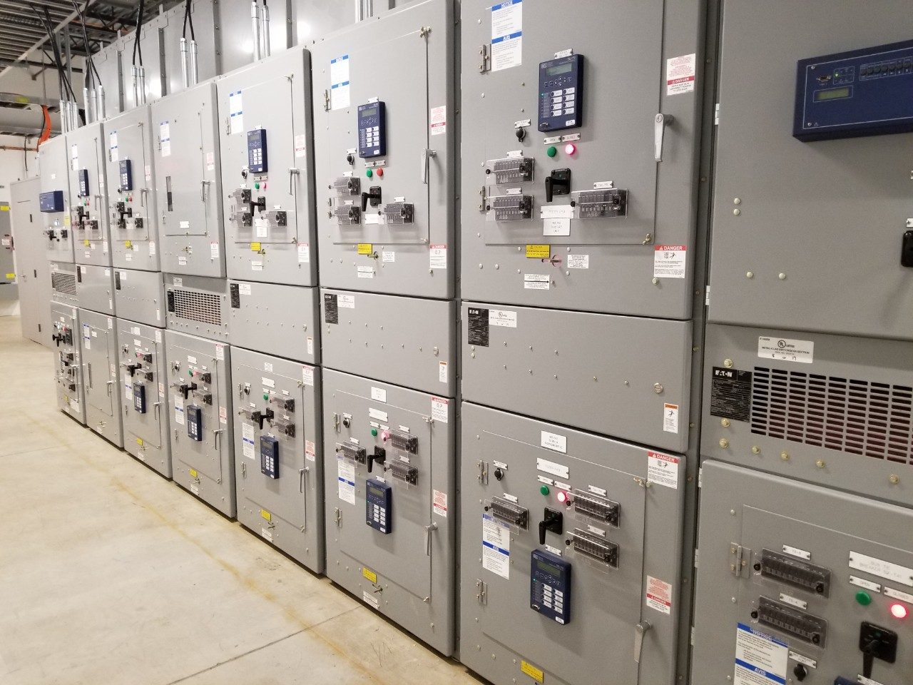


Team 54: Remote Thermal Viewing within High Voltage
Bi-Weekly Update 4 Blake Bagley, Julia Garcia, Erica Mathew Sponsor: Powell Industries TA: Vishwam Raval

Slide 2
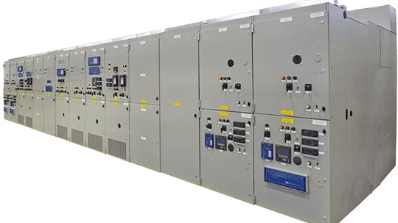

Project description
Problem statement: “As industry demand grows, space inside high voltage switchgear has become increasingly limited. Manufacturers are required to fit more devices and wires within the same limited space. Additionally, manufacturers are now being asked to include a remote viewing system within the switchgear to monitor a physical ground switch. This ground switch is physically blocked, by wires, from the view of the operator. A remote viewing system allows the operators job to be much safer and more convenient.”
Notes:
Erica: Our project sponsor is powell industries which is a “Powell Industries designs and manufactures equipment like switchgear, circuit breakers, and power management systems that help safely control and distribute electrical power in multiple different industries
Switchgears are Switchgears are devices that control and protect electrical circuits by turning power on or off and preventing damage during electrical faults.
Powell industries designs/maufactures
explain switchgears
explain project

Slide 3

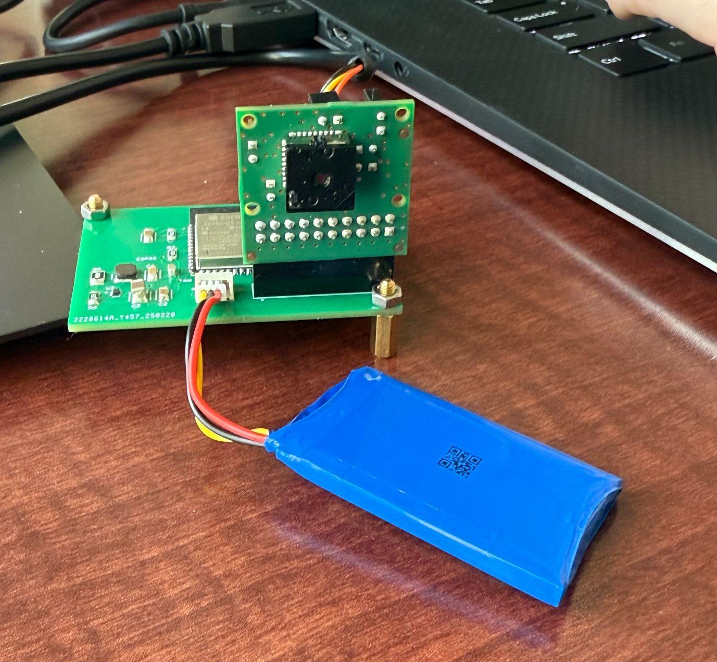
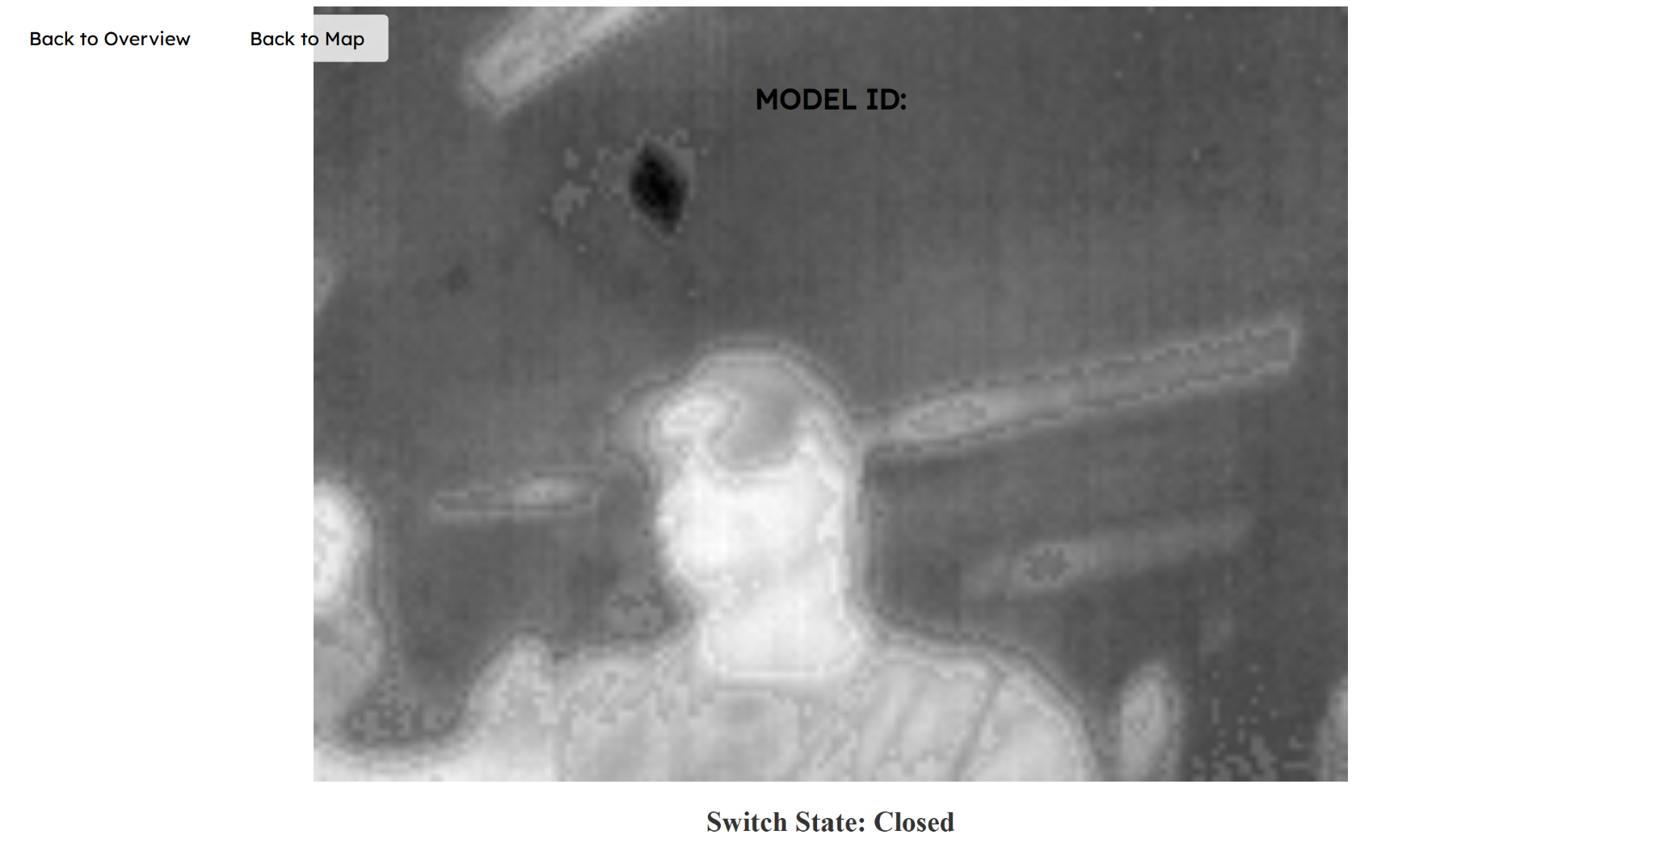
Integrated System Diagram
Microcontroller sends images to Website through HTTP Post
Thermal Sensor takes images
Website displays images one by one

Slide 4
Project Timeline
Jan 22: Designed and ordered new PCB + started integrating Microcontroller/Website | Feb 3: Have PCB soldered and tested + Website/Microcontroller connection | Feb 17: Microcontroller can send image data to website + ESP32 on PCB able to download code | Feb 24: Have PCB working and have microcontroller programmed + switch state communication | Mar 3: All Integration between subsystems complete | Mar 17: Encase Prototype for Dielectrics Test + Practice Demo | Mar 24: Practice Demo + Completing Final Report + Preparing for Showcase
Notes:
Eric

Slide 5
Subsystem 1: PCB
Julia
Accomplishments since last update 15 hrs of effort | Ongoing progress/problems and plans until the next presentation
Hardware is complete Replacement board is soldered ESP32 buck converter is working correctly ESP32 is able to download code, connect to wifi, and “talk” to the camera Hardware and software integration is complete | The plastic sheet is too thick for the camera to see through 3D printing a box using ABS plastic with a window made of thin IR material

Slide 6
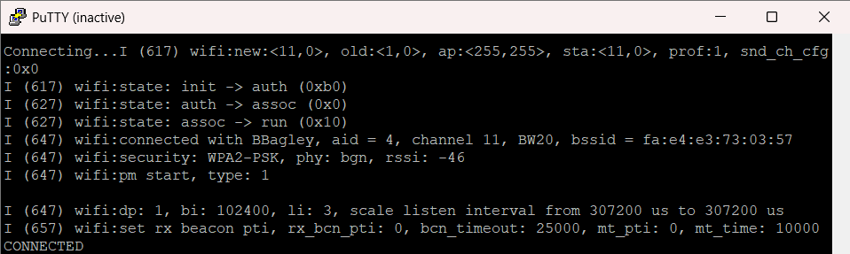
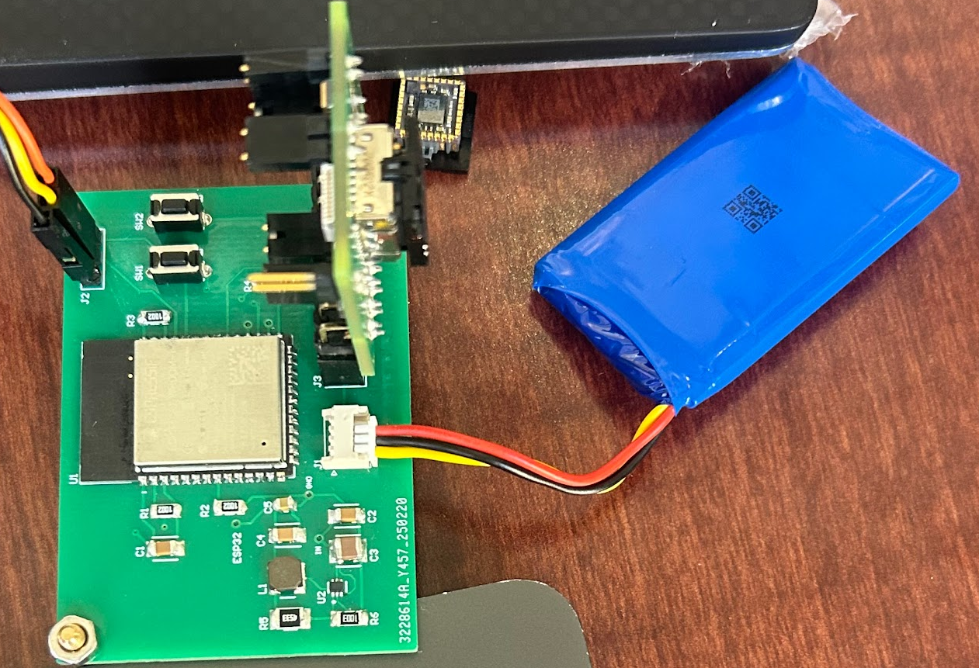
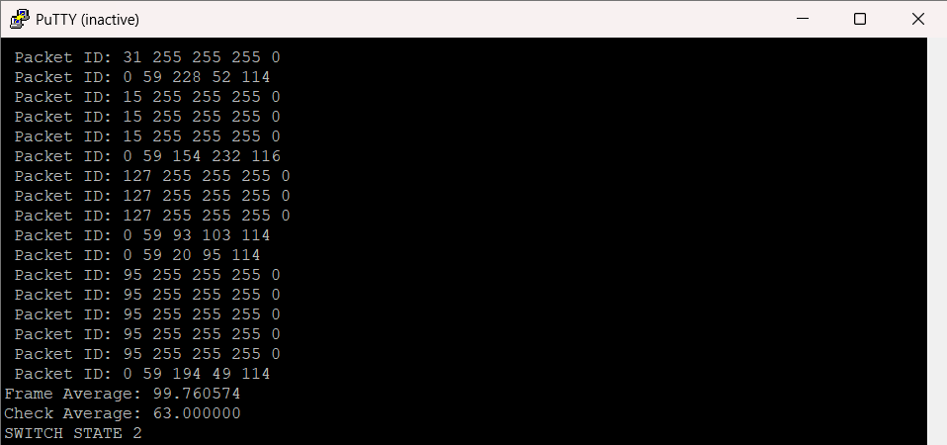
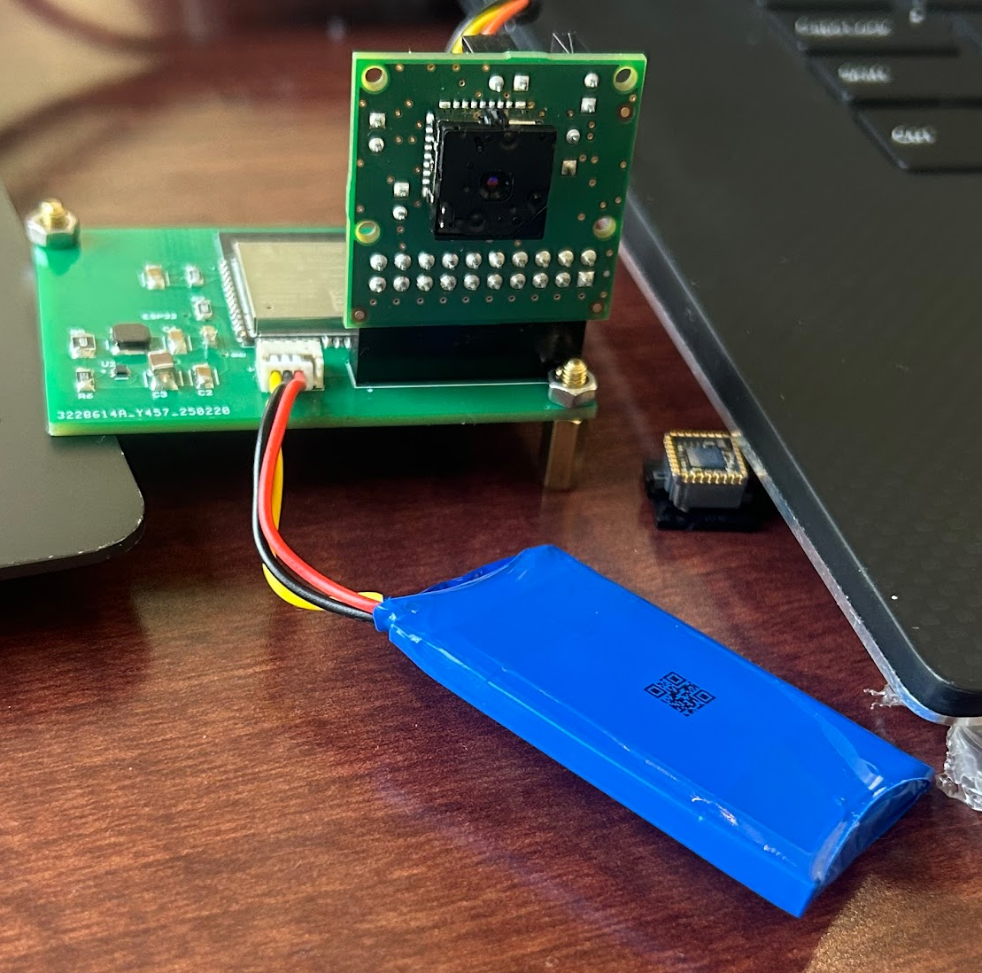
Subsystem 1: PCB
Julia
ESP32 on board connecting to WiFi
ESP32 on board receiving image data
Thermal Imaging Apparatus

Slide 7
Subsystem 2: Microcontroller
Blake
Accomplishments since last update 23 hrs of effort | Ongoing progress/problems and plans until the next presentation
The code for switch-state determination is fixed Microcontroller is sending multiple frames Microcontroller is sending switch-state data | Creating the encasing for the prototype Putting together demos for the prototype (still waiting on sponsor to give dimensions of switchgear)

Slide 8
Subsystem 2: Microcontroller
Blake

Slide 9
Subsystem 3: Website
Erica
Accomplishments since last update 15 hrs of effort | Ongoing progress/problems and plans until the next presentation
Website is able to receive continuous image frames at a steady pace Website is able to receive and display Switch State Determination Majority of software integration is complete | Fix minor cosmetic details on website

Slide 10
Subsystem 3: Website
Erica
Website is able to receive continuous image frames
Website is able to receive Switch State Determination for each frame

Slide 11
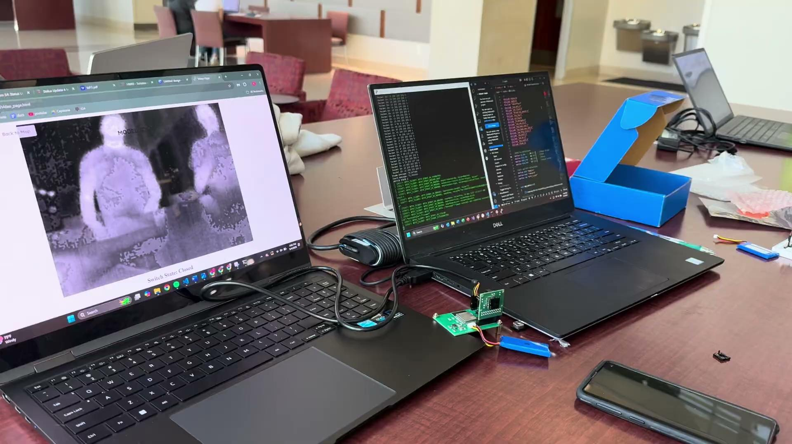
Demo of Integration

Slide 12
Execution plan
 | 1/20/25 | 1/27/25 | 2/3/25 | 2/10/25 | 2/17/25 | 2/24/25 | 3/3/25 | 3/10/25 | 3/17/25 | 3/24/25 | 3/31/25 | 4/7/25 | 4/14/25 | 4/21/25 | 4/28/25
PCB Updated
Updated PCB ordered
Parts Ordered
Researched Integration
Microcontroller Code Modified
Website Code Modified
Status Update #1
New boards soldered
Verify Server can receive data from microcontroller
Buck converters tested
Website and Microcontroller Connection
Plastic Insulating sheet ordered |  |  |  |  |  |  |  |  | Not Started
Status Update #2 |  |  |  |  |  |  |  |  | In Progress
MCU and Website communication tested |  |  |  |  |  |  |  |  | Completed
PCB and Microcontroller Integration |  |  |  |  |  |  |  |  | Behind
Plastic Insulating Box made
MCU and Website Communicate Switch State
Status Update #3
Website and Microcontroller Fully Integrated
Full System Integration
Status Update #4
Dielectrics Testing
Troubleshoot any issues
Practice Demo
Status Update #5
Final Presentation
Final Demonstration
Final Report

Slide 13
Validation Plan
Test Name | Success Criteria | Methodology | STATUS | Engineers
Input Voltage | The voltage powering the whole PCB should be ~3.7 Volts | Use a multimeter to measure the DC voltage | PASSED | Julia
Converter Voltage | The buck converter providing voltage should produce ~3.3 Volts | Use multimeter to measure the DC voltage | PASSED | Julia
Board Communication | The ESP32 should receive data from camera | Use oscilloscope to measure the data stream | PASSED | Julia
Microcontroller connect to website | The Website successfully received an HTTP POST request from the microcontroller. | Checking the console log of both the website and microcontroller | PASSED | Erica + Blake
Microcontroller sending an image data | The website successfully received raw image data | Checking console log on website and converting the raw image data to a png | PASSED | Erica + Blake
Switch State Working | The microcontroller should be able to identify the Switch State of a makeshift switch | The microcontroller will monitor a show box with an LED to demonstrate switch state determination | UNTESTED | Blake
The PCB should pass dielectrics test | The PCB should pass the dielectrics test and not cause any interference with the switchgear. | This will be tested at POWELL Industries | UNTESTED | Julia
Website can display switch state determination | The website should be able to accurately display the Switch State Determination. | We will test the State determination at POWELL/ with a makeshift switch | TESTED | Erica + Blake
Website can load and display images in real time | The website should be able to display a few frames per second to mimic a slow video stream. | When the camera is running, we will monitor the latency on the website | TESTED | Erica + Blake

Slide 14
Thank you for listening!

